Slide 1

Java Cryptography
Dima Ionut Daniel

Slide 2
Contents
What is Java ?
History
What is Cryptography ?
Core
Message Digests
Random Numbers
Cipher Encryption
Bibliography

Slide 3

What is Java ?
Java is a programming language created by Sun Microsystems.
Java is used in a wide variety of computing platforms from embedded devices and mobile phones on the low end, to enterprise servers and supercomputers on the high end.
Java eliminates certain low-level constructs such as pointers and has a very simple memory model where every object is allocated on the heap and all variables of object types are references.
Memory management is handled through integrated automatic garbage collection performed by the JVM.

Slide 4
What is Java? (cont.)
The heart of the Java platform is the concept of a "virtual machine" that executes Java bytecode programs. This bytecode is the same no matter what hardware or operating system the program is running under.
There is a JIT(Just-In-Time) compiler within the Java Virtual Machine, or JVM. The JIT compiler translates the Java bytecode into native processor instructions at run-time and caches the native code in memory during execution. The use of a JIT compiler means that Java applications, after a short delay during loading and once they have "warmed up" by being all or mostly JIT-compiled, tend to run about as fast as native programs.
The Java programs are cross-platform or platform independent, but the code of the Java Virtual Machines (JVM) that execute these programs is not.

Slide 5
History
The initial Java release was named Oak, and the first stable version was JDK 1.0.2, called Java 1.
JDK 1.0 - 23 January 1996
JDK 1.1 – 19 February 1997
J2SE 1.2 – 8 December 1998 (codename Playground)
J2SE 1.3 – 8 May 2000 (codename Kestrel)
J2SE 1.4 – 6 February 2002 (codename Merlin)
J2SE 5.0 – 30 September 2004 (codename Tiger)
Java SE 6 – 11 December 2006 (codename Mustang)
Java SE 7 – 7 July 2011(codename Dolphin)
Java SE 8 – 18 March 2014 (codename Spider)
Java SE 9 – planned for 2016

Slide 6
What is Cryptography ?
Cryptography is the science of secret writing.
The main security concerns of applications are addressed by cryptography.
Adding cryptography to an application will not make it secure.
Security is determined by the overall design and implementation of the system.

Slide 7
What is Cryptography ? (cont.)
Cryptography provides bellow security features:
Confidentiality assures that data cannot be viewed by unauthorized people.
Integrity assures that data has been changed without our knowledge.
Authentication assures that people are who say they are.

Slide 8
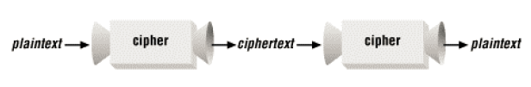
What is Cryptography ? (cont.)
A common way to protect information is to encrypt data at the sending and decrypt data when receiving.
Encryption is the process of taking data called plaintext and transforming it into an unreadable mess called ciphertext.

Slide 9
Core
Base64 is a system for representing an array of bytes as ASCII characters.
Base64 system is fully described in RFC 1521.
There are 2 java classes in Java: sun.misc.BASE64Encoder, sun.misc.BASE64Decoder.

Slide 10
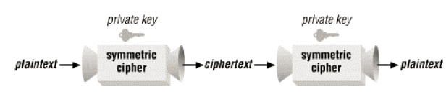
Core (cont.)
Useful ciphers are keys to encrypt and decrypt data.
A symmetric cipher uses the same key at the sending and receiving end.
Symmetric ciphers are also called private key or secret key ciphers.

Slide 11
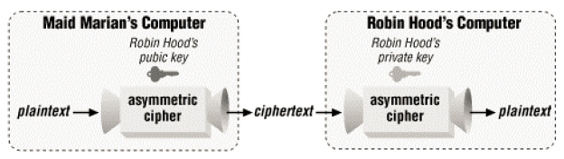
Core (cont.)
The shortcomings of symmetric ciphers are addresses by asymmetric ciphers, also called public key ciphers.
Data encrypted using the public key can be decrypted using the private key.

Slide 12
Core (cont.)
Hybrid systems combine symmetric and asymmetric ciphers.
The beginning of a conversation involves some negotiation carried out using an asymmetric cipher, where the participants agree on a private key or session key.
The session key is used with a symmetric cipher to encrypt/decrypt data.

Slide 13

Core (cont.)
A message digest can be used to verify data integrity.
A message digest is a special number calculated from a set of input data.

Slide 14
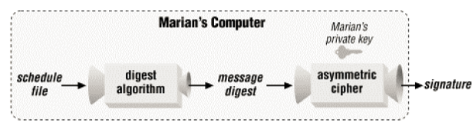
Core (cont.)
A Message Authentication Code (MAC) is a message digest with an associated key.
It produces a short value based on both its input data and the key.
If A encrypts the message digest with her private key, B can download the encrypted message digest, decrypt it using A's public key, and compare the message digest to one that he computes from the downloaded file. If they match, then he can be sure that the file is correct.
The encrypted message digest is called a signature.

Slide 15
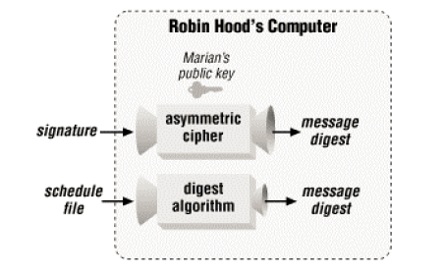
Core (cont.)
Bellow is the validation process described.

Slide 16
Core (cont.)
The process of providing identity is called authentication.
An asymmetric cipher can be used for authentication.
Asymmetric ciphers are computationally expensive, so not every time are the best choice.
(Secure Sockets Layer) SSL helps exchanging the session key.

Slide 17
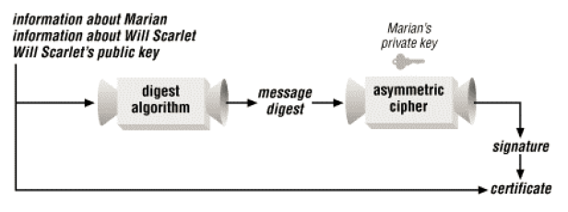
Core (cont.)
A certificate is a signed public key.
The verification process is described bellow:
1. Calculate a message digest for the certificate contents (except the signature).
2. Decrypt the signature using the signer's (Marian's) public key. The result is a message digest.
3. Compare the decrypted message digest to the calculated message

Slide 18
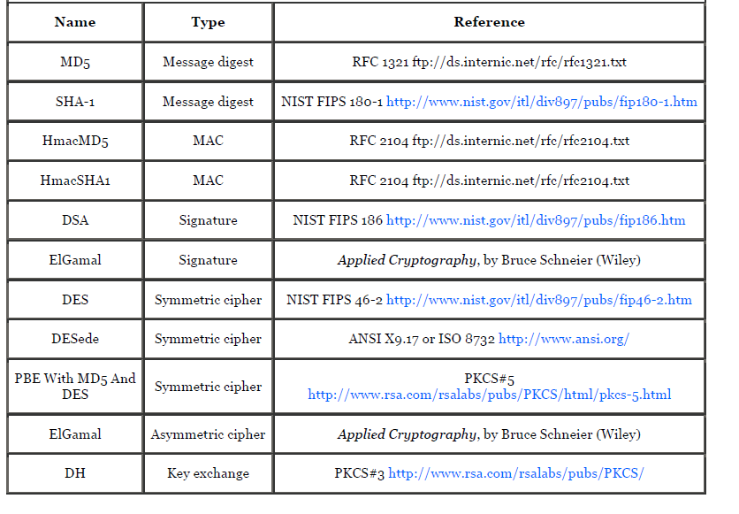
Core (cont.)

Slide 19
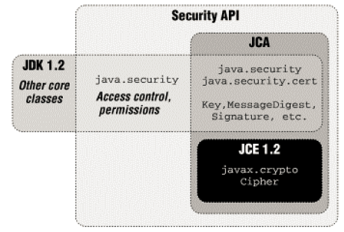
Core (cont.)
Java cryptography comes with cryptography classes for authentication.
Java Cryptography Extension (JCE) includes so-called "strong cryptography".

Slide 20
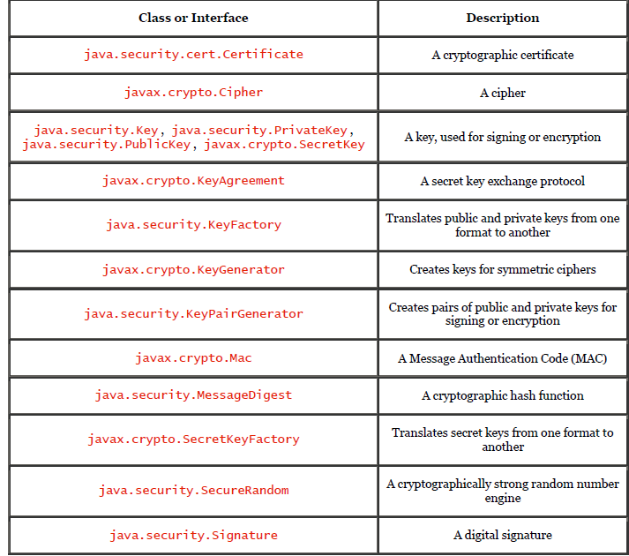
Core (cont.)

Slide 21
Core (cont.)
A generator class creates keys from scratch.
Symmetric keys are generated by the KeyGenerator class.
Assymetric key pairs are generated by the KeyPairGenerator class.
The KeyFactory class translates between key objects and their external representations.

Slide 22
Core (cont.)
The java.security.Key class represents a single key.
Because keys must be transferred to and from various entities they must be serializable.
The key returns the algoritm used to generated the key, the format and the encoded byte[] array.
The java.security.PublicKey and java.security.PrivateKey classes extends the Key class.

Slide 23
Core (cont.)
The java.security.KeyPairGenerator class can be used to generate a pair of asymmetric keys.
The implementation has the algorithm and provider parameters.
The initialize() method initializes the key pair generator to generate keys of the given strengh.
The DSA strength must be between 512 and 1024 and must be multiple of 64.
The RSA strength must be between 512 and 2048.

Slide 24
Core (cont.)
The java.security.cert.Certificate class represents a certificate entity.
To verify that the certificate is valid we need to have the public key of the certificate authority that issued it.
X509 is a certificate format represented in java by the X509Certificate class.

Slide 25
Core (cont.)
Keys are stored to using a key management system.
Keystores are created and manipulated though an administrative tool(keytool) and there is a Java API that allows to use keystore programatically.
Key management terms:
keystore: file that holds set of keys and certificates.
alias: every key in the keystore belongs to an entity.
DN(distinguished name): subset of X.500 name.
key entry: may hold an asymmetric key pair or a single secret key.
certificate entries: contains only a public key certificate.
JKS,JCEJS,PKCS12: different algorithms of keystores.

Slide 26
Core (cont.)
The keytool is an utility for CRUD operations in the keystore.
We can generate keys using bellow command:keytool -genkey -alias test -keyalg RSA
We can generate certicates: keytool -certreq -alias test -file test.cert
We can import certificates: keytool -import -file test.cert -alias test -trustcacerts

Slide 27
Message Digests
Message digests are the simplest of the standard engines.
A secure message digest is called a Message Authentication Code (MAC).
MAC requires a secret key that is shared by the sender and receiver.
Sun's implementation of JCE provides 2 algorithms for calculation MAC: HmacSHA1 and HmacMD5.
We have message diggest streams classes like: java.security.DigestOutputStream and java.security.DigestInputStream.

Slide 28
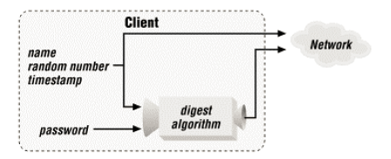
Message Digests (cont.)
Example of protecting a password:

Slide 29
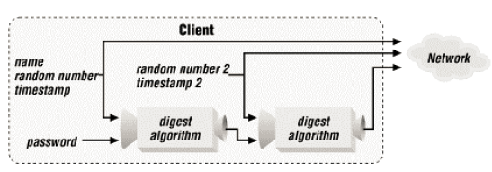
Message Digests (cont.)
Example of double protecting a password:

Slide 30
Random Numbers
Random numbers are crucial in cryptography.
They are used to create cryptographic keys and, in some cases, to encrypt or sign data.
A random number is one whose value cannot be predicted.
A random number generator (RNG) is a device that produces random numbers.
Computers use a pseudo-random number generator (PRNG) as a source of "random" data.
A PRNG uses an algorithm to generate an endless sequence of random numbers.

Slide 31
Random Numbers (cont.)
The JDK includes a class, java.util.Random, that implements a PRNG.
A stronger PRNG, java.security.SecureRandom, was introduced in JDK 1.1.
SecureRandom uses the SHA-1 (Secure Hash Algorithm) message digest algorithm, which produces a 20-byte digest.

Slide 32
Cipher Encryption
Cipher based encryption is part of JCE and contains a cipher engine that performs encryption.
The engine class is javax.crypto.Cipher for encryption and decryption.
SunJCE security provider: DES(Data Encryption Standard), DESede(triple-DES), PBEWithMD5AndDES, Blowfish
SunJCE modes: ECB, CBC(cipher block chaining), CFB(cipher-feedback mode), OFB(output-feedback mode), PCBC.
SunJCE padding schemes: PKCS5Padding, NoPadding.

Slide 33
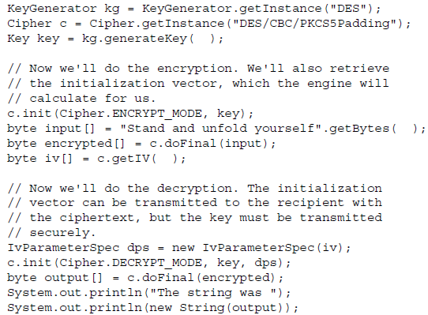
Cipher Encryption (cont.)

Slide 34
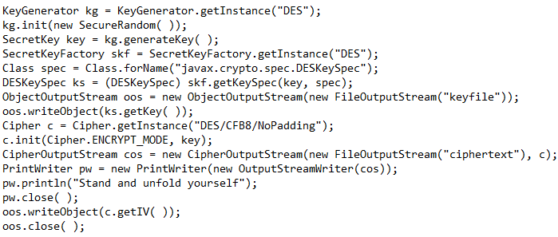
Cipher Encryption (cont.)
The SPI for javax.crypto.Cipher class is the javax.crypto.CipherSpi class.
The class is responsable for performing the encryption or decryption according the the internal algorithm.
Support for various modes or padding schemes must be handled by this class.
Classes like javax.crypto.CipherOutputStream or javax.crypto.CipherInputStream have the abbility to associate a cipher object with and input or output stream.

Slide 35
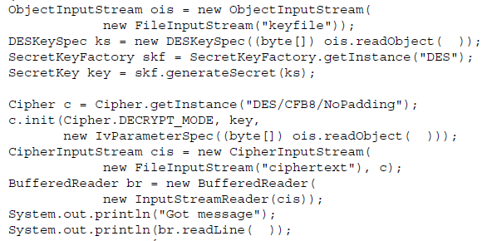
Cipher Encryption (cont.)
Bellow is an example of decryption:

Slide 36

Bibliography
O'Reilly – Java Cryptography

